Slide 1
Presentation
1

Slide 2

Sleep Paralysis
Sleep Paralysis
HAMMAD MUSTAFA
Notes:
https://unsplash.com/photos/p0j-mE6mGo4

Slide 3
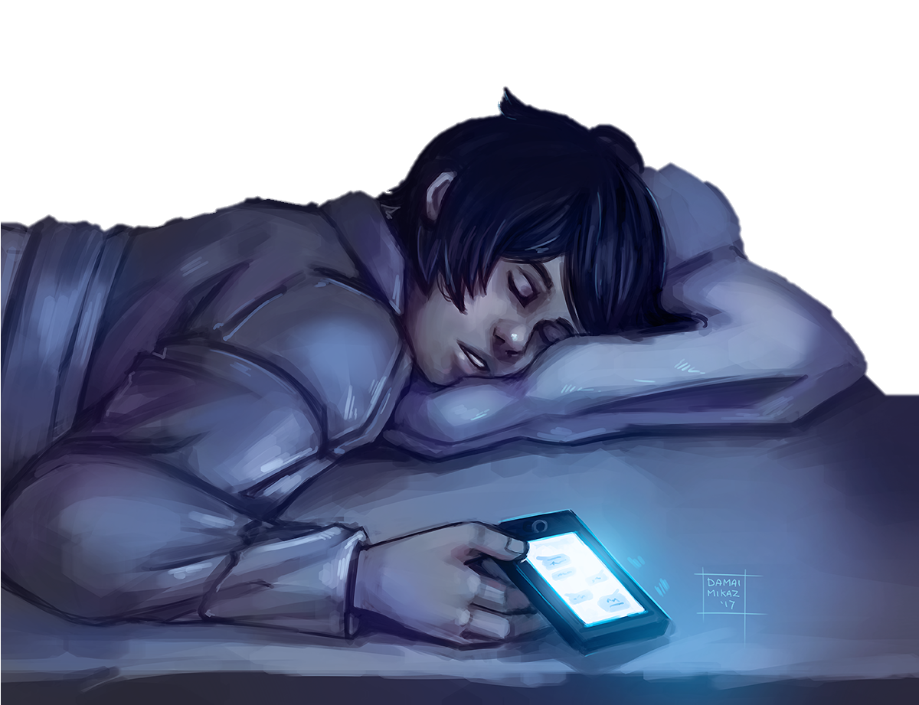
Me scrolling through Instagram at 3 AM
My sleep paralysis demon waiting for me to sleep

Slide 4

My sleep paralysis demon waiting for me to sleep

Slide 5
Presentation
2

Slide 6
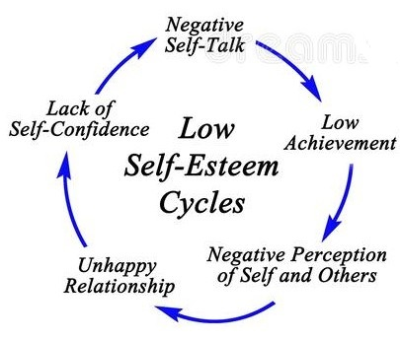
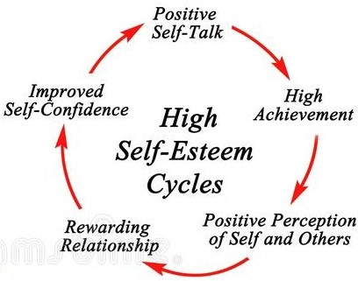
Low VS High Self-Esteem
Negative self-talk
Constant self-criticism
Avoiding new challenges.
Self-acceptance and embracing uniqueness.
Confidence and belief in oneself.
Resilience and positive mindset.

Slide 7
Presentation
3

Slide 8






Slide 9

Eden
Adam
Kirsten Dust
Jim Sturgess

Slide 10
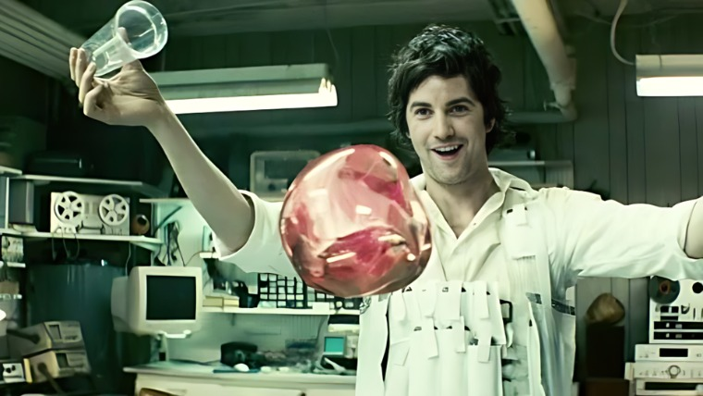

"Gravity. They say you can't fight it. Well, I disagree.
What if love was stronger than gravity?"

Slide 11
Presentation
4

Slide 12
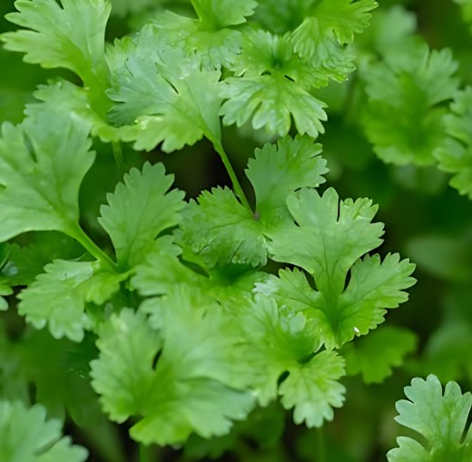
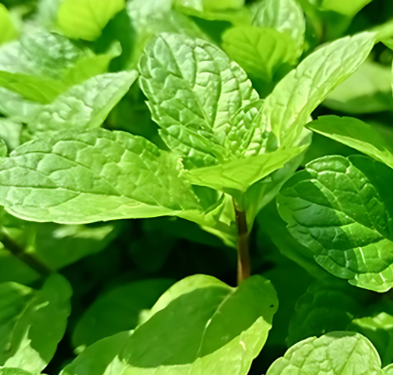
DISCIPLINE
v s
MOTIVATION

Slide 13

Let’s summarize
What is self Discipline?
Self Control
Consistency and will power
Time management

Slide 14
Let’s summarize
What is self Discipline?
How to develop self Discipline?
Create daily routines
Self Control
Consistency and will power
Practice extreme ownership
Time management
Embrace discomfort and hard work

Slide 15
Let’s summarize
How to set goals effectively?
How to develop self Discipline?
Specific
Create daily routines
Practice extreme ownership
Measurable
Embrace discomfort and hard work
Achieveable
Relevant
Time bound

Slide 16

Thank you
Conclusion
In the world full of competence, if we want to achieve something truly remarkable, we need to put ourselves apart from others. And that we can do with self discipline and effective goal setting

Slide 17
Lecture one
Presentation
1
5

Slide 18

- Insert at position
Imagine you have following linked list and you want to insert ’31’ at 4th position or index 3, which comes after 26.
Now let’s see how this is achieved in code.
head
tail
N
U
L
L
21
25
26
23
37
61
13

Slide 19
Condition true
Delete at end
>>>
Condition false
node *cur = head;
node *pre = NULL;
while(cur->next != NULL){
pre = cur;
cur = cur->next;
}
>>>
Part 1: Getting to second last node
>>>
>>>
>>>
>>>
head
tail
Now we have reached second last node, it’s time to delete last node
N
U
L
L
21
25
26
37
61
cur
pre
NULL
20

